Slide 1
The Rady School of Management
Lecture #7
January 29, 2020
Global Consumers and Markets
Case Study #2 – Starbucks in Milan
MGT103
M,W 11:00a - 12:20p
Winter 2020

Slide 2
Key Talking Points for Today……
The nature and scope of world trade from a global perspective.
The major developments that have influenced world trade and global marketing.
Environmental forces that shape global marketing efforts.

Slide 3
Key Talking Points for Today……
Name and describe the alternative approaches companies use to enter global markets.
The distinction between standardization and customization when companies craft worldwide marketing programs.

Slide 4
DYNAMICS OF WORLD TRADE (1 of 2)
Global Perspective
U.S., China, Japan, West. Europe, Canada Account for Two-Thirds of World Trade
Products and Commodities: 80 Percent of World Trade, Services: 20 Percent
Exports and Imports Have Complementary Economic Flow
Trade Feedback Effect
Countertrade

Slide 5
DYNAMICS OF WORLD TRADE (2 of 2)
United States Perspective
U.S. Share of World Exports Has Decreased
U.S. World Imports Have Increased
Gross Domestic Product (GDP)
Balance of Trade
Largest Importers of U.S. Products: Canada, Mexico, China, Japan

Slide 6
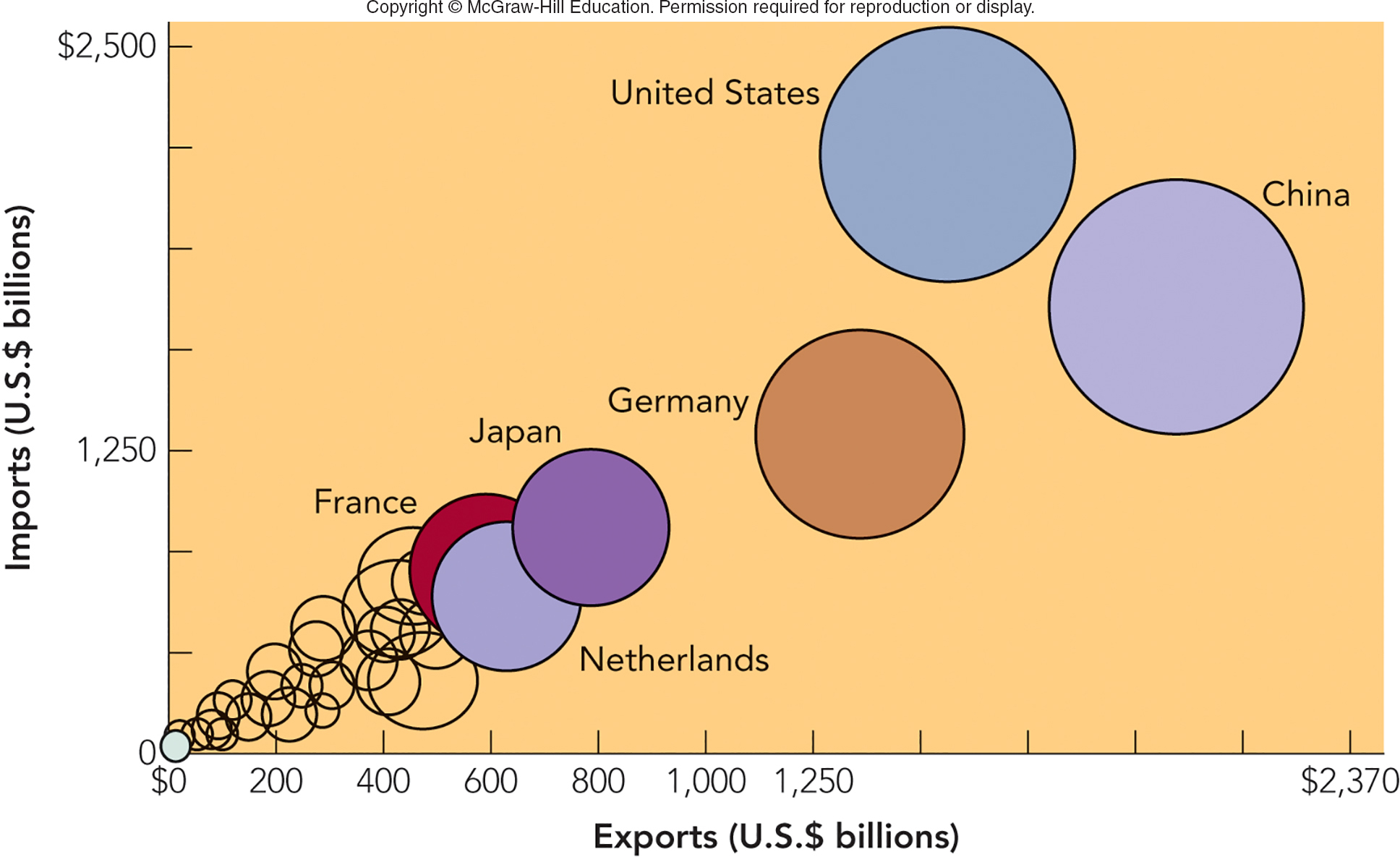
FIGURE 7-1 Leading countries in global merchandise trade in terms of imports (U.S.) and exports (China).
Jump to Appendix 1 long image description

Slide 7
MARKETING IN A DYNAMIC GLOBAL ECONOMY ECONOMIC PROTECTIONISM BY COUNTRIES
Protectionism
Tariffs
Quota
World Trade Organization (WTO)

Slide 8
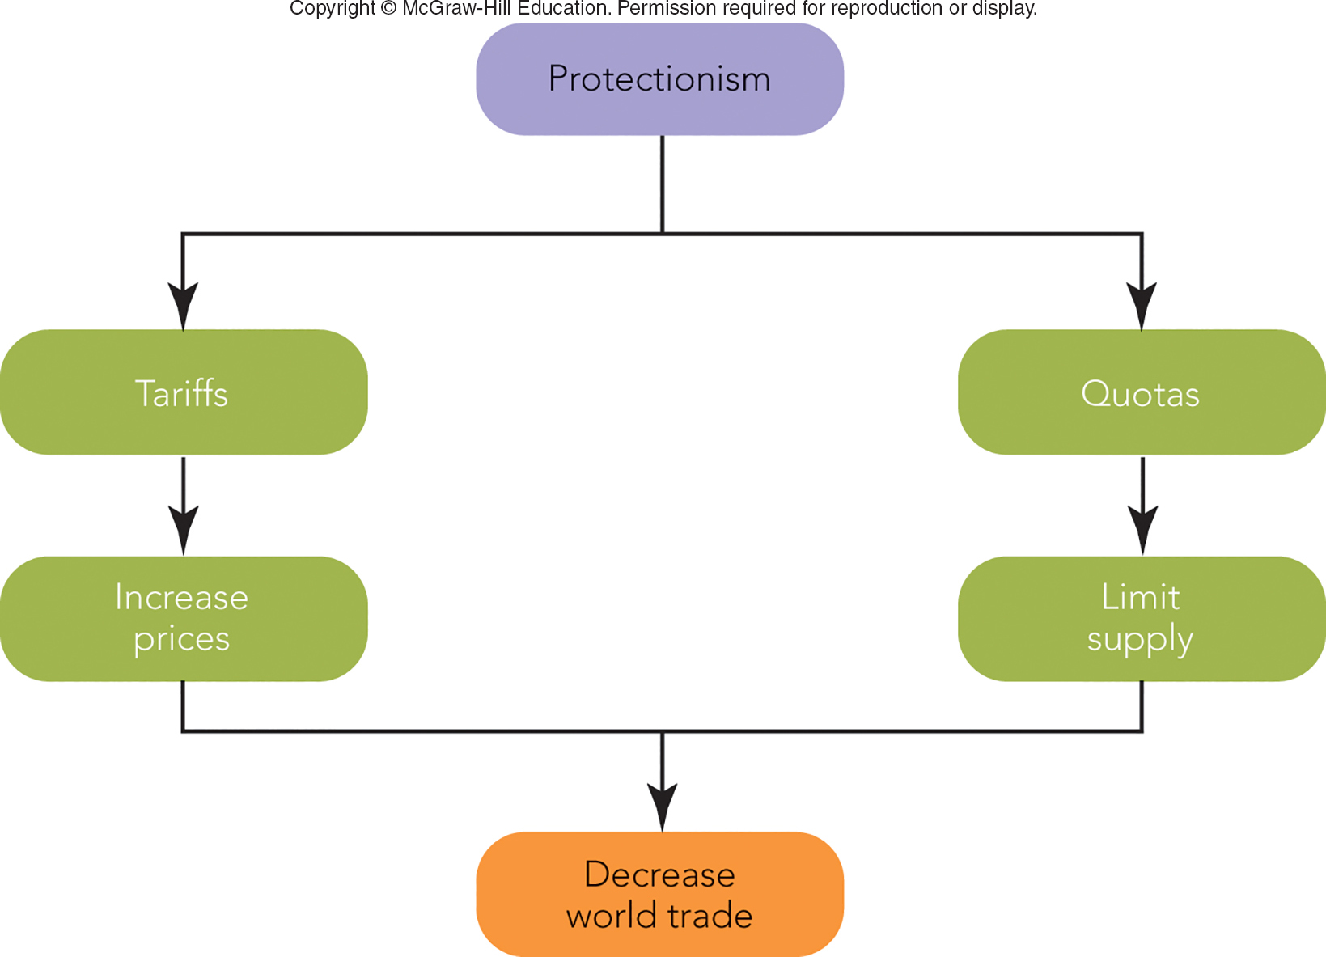
FIGURE 7-2 Protectionism hinders world trade when countries raise prices and limit supply through tariff and quota policies
Jump to Appendix 2 long image description

Slide 9
MARKETING IN A BORDERLESS ECONOMIC WORLD RISE OF ECONOMIC INTEGRATION
European Union (EU)
28 Countries Eliminated Barriers to Trade (750 Million Consumers)
North American Free Trade Agreement (NAFTA)
Lifted Trade Barriers Between Canada, Mexico, and U.S. (475 Million Consumers)
46 Percent of U.S. Exports Are to Free Trade Partners

Slide 10
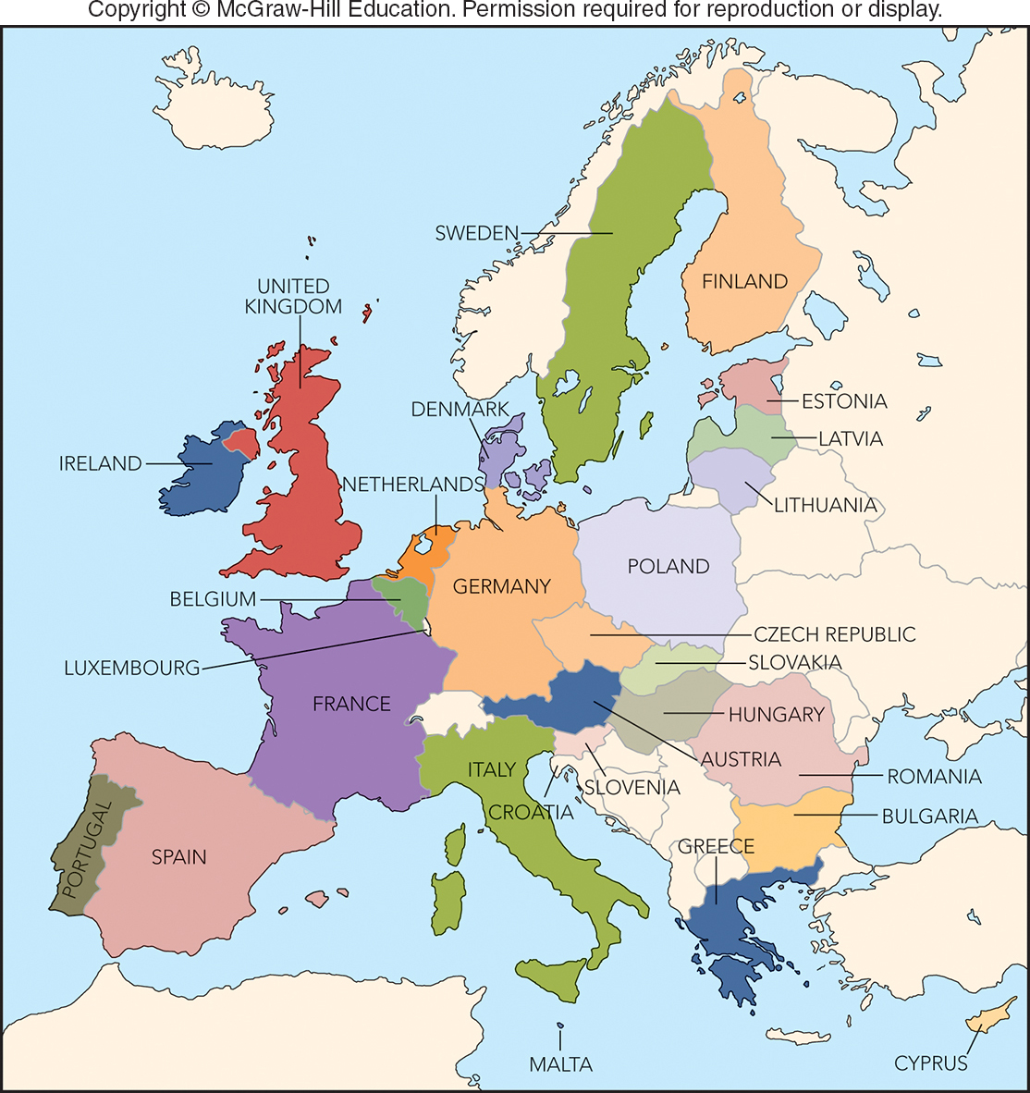
FIGURE 7-3 The European Union in 2018 consists of 28 countries with about 750 million consumers.

Slide 11

MARKETING IN A BORDERLESS ECONOMIC WORLD GLOBAL COMPETITION FOR GLOBAL CUSTOMERS (1 of 2)
Global Competition
Firms Originate, Produce, and Market Products Worldwide
Strategic Alliances
Courtesy Mary Kay, Inc.

Slide 12
FIGURE 7-A Global Companies and Marketing Strategy
TYPE OF GLOBAL COMPANY | TYPES OF MARKETING STRATEGY
International Firm | Extension of Home Marketing Strategy
Multinational Firm | Multi-domestic Marketing Strategy
Transnational Firm | Global Marketing Strategy

Slide 13
MARKETING IN A BORDERLESS ECONOMIC WORLD GLOBAL CONSUMERS
Global Consumers
Consumer Groups in Different Countries with Similar Needs
Ex: Middle-Class, Youth Market, Elite Segment, etc.
Companies Benefit from Similarities in Markets

Slide 14

MARKETING MATTERS The Global Teenager—A Market of Voracious Consumers
Global Market of Teens:
Exposure to TV, Movies, Travel, Social Media, and Global Advertising
Teens’ Rooms Look Similar, No Matter the Country
Teens Spend $820 Billion Annually for Common Products (Jeans, Video Games, etc.)
U.S. Trends Influence Attitudes and Purchase Behavior
©Kim Petersen/Alamy Stock Photo

Slide 15
MARKETING IN A BORDERLESS ECONOMIC WORLD PREVALENCE OF ECONOMIC ESPIONAGE
Economic Espionage Exists!
Clandestine Collection of Trade Secrets or Proprietary Information about Competitors
Costs U.S. Firms $400+ Billion/Year
23 Nations Routinely Target U.S. Firms
Economic Espionage Act (1996) Makes Theft a Federal Crime

Slide 16
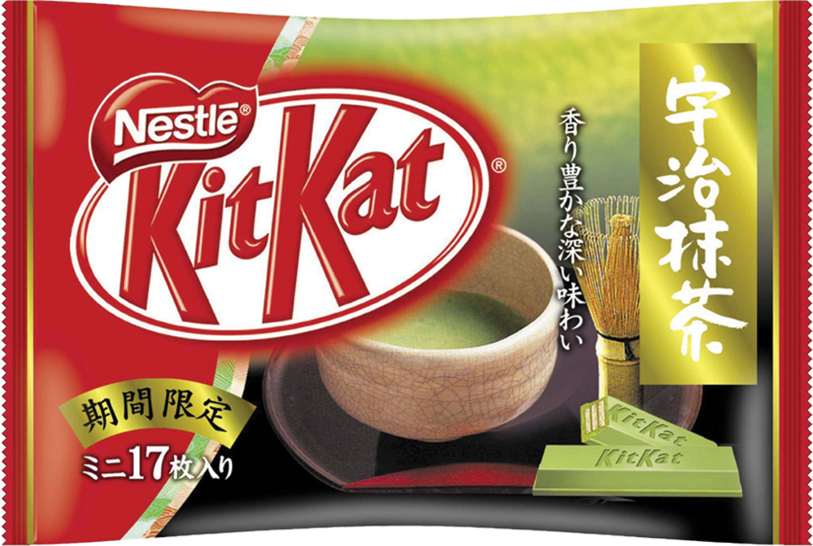
A GLOBAL ENVIRONMENTAL SCAN CULTURAL DIVERSITY (1 of 3)
Cross-Cultural Analysis
Study of Similarities and Differences
Values
Preferable Modes of Conduct that Persist Over Time
Customs
Considered Normal in a Country
Foreign Corrupt Practices Act (1977)
©CB2/ZOB/WENN/Newscom

Slide 17
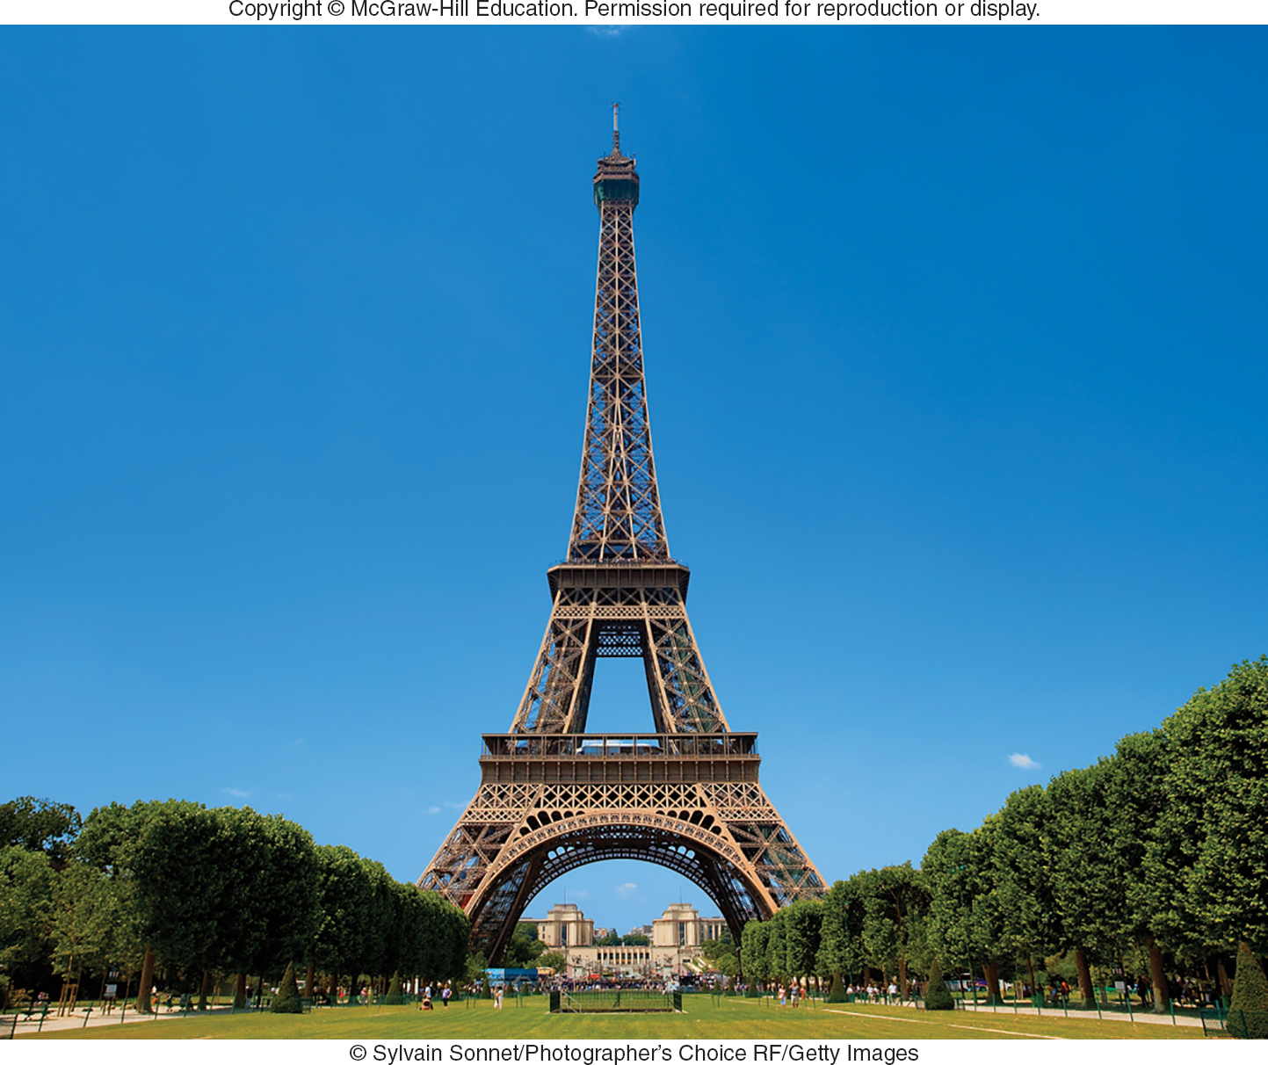
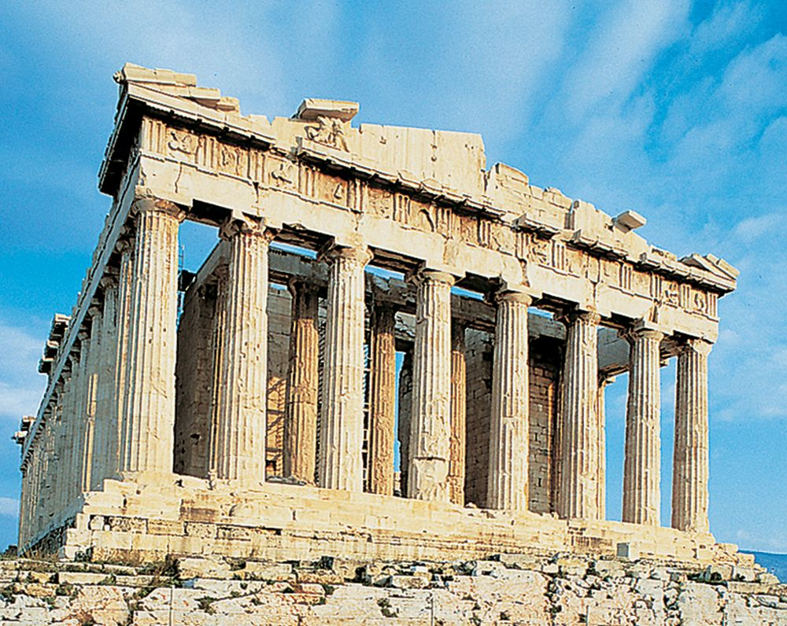
A GLOBAL ENVIRONMENTAL SCAN CULTURAL DIVERSITY (2 of 3)
Cultural Symbols
Represent Ideas and Concepts in a Culture
Evoke Deep Feelings
(first): ©Sylvain Sonnet/Photographer’s Choice RF/Getty Images; (second): ©Antonio M. Rosario/Getty Images

Slide 18
COMPARING MARKET-ENTRY STRATEGIES ALTERNATIVE APPROACHES
Options for Market Entry:
Exporting
Indirect Exporting
Direct Exporting
Licensing
Joint Venture
Direct Investment

Slide 19
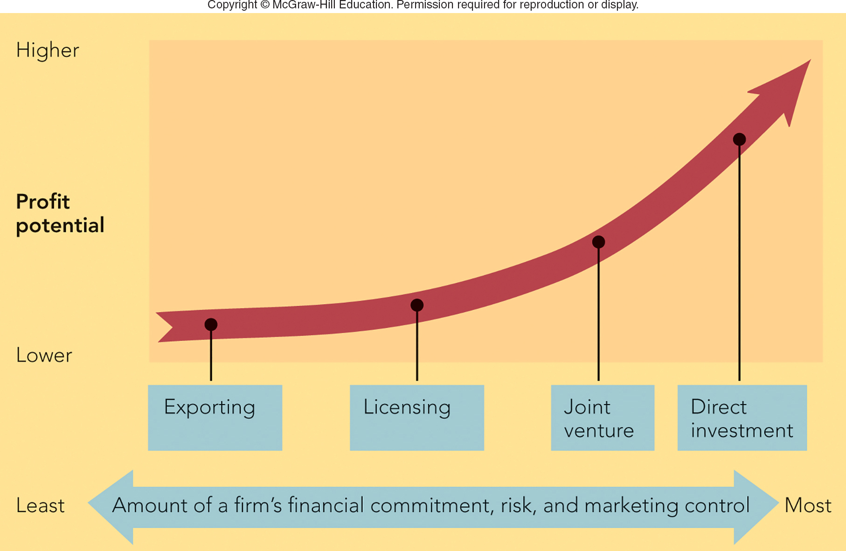
FIGURE 7-4 Alternative global market-entry strategies
Jump to Appendix 3 long image description

Slide 20
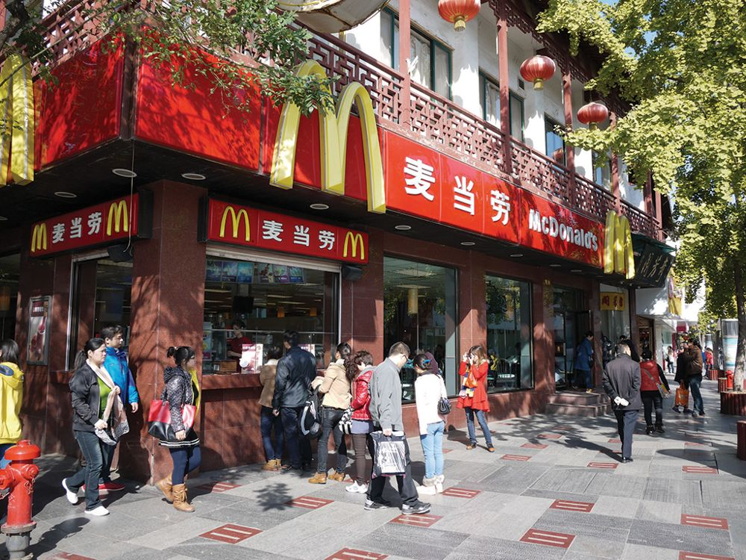
GLOBAL MARKET-ENTRY STRATEGIES LICENSING
Licensing:
Offers Right to a Trademark, Patent, Trade Secret, or Intellectual Property for a Royalty or Fee
Advantages and Disadvantages?
Franchising:
Fastest-growing Market-entry Strategy
Advantages and Disadvantages?
©China/Alamy Stock Photo

Slide 21
GLOBAL MARKET-ENTRY STRATEGIES JOINT VENTURE
Joint Venture
Sharing Ownership, Control, and Profits
Advantages and Disadvantages?
Direct Investment
Biggest Commitment to Enter Global Market
Advantages and Disadvantages?

Slide 22
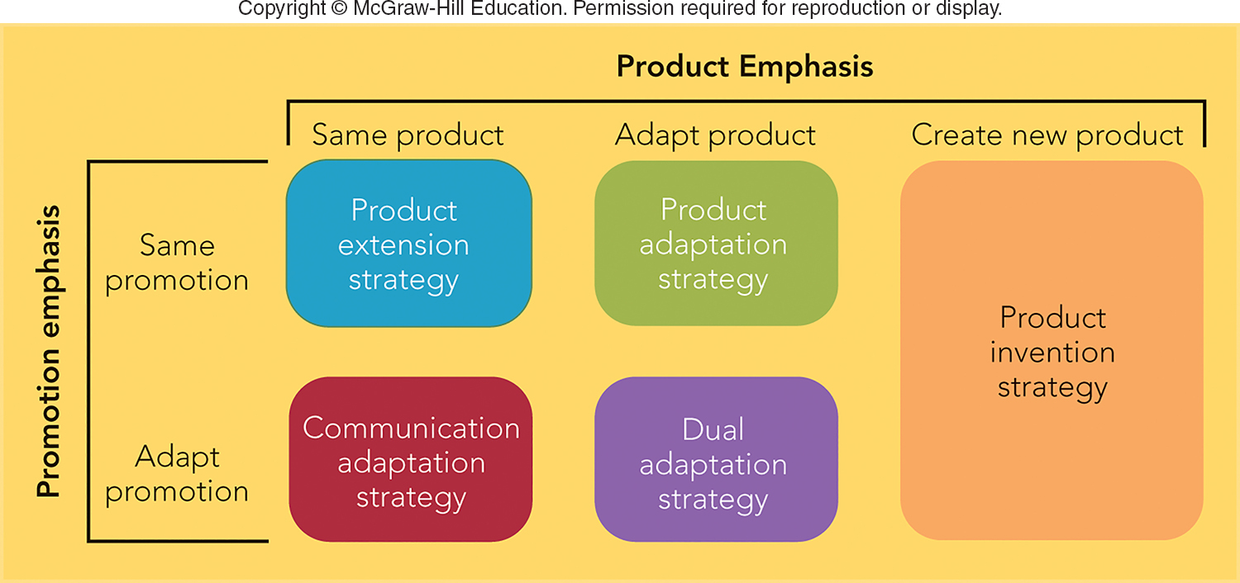
FIGURE 7-5 Five product and promotion strategies for global marketing
Jump to Appendix 4 long image description

Slide 23

CRAFTING A WORLDWIDE MARKETING PROGRAM PRODUCT AND PROMOTION STRATEGIES (2 of 2)
Possible Communication Strategies:
Identical Message around the World
Communication Adaptation:
Same Product but Different Advertising
Dual Adaptation
Modifying Both Products and Promotion Messages
Nescafe China

Slide 24
CRAFTING A WORLDWIDE MARKETING PROGRAM DISTRIBUTION AND PRICING STRATEGIES
Distribution Is Critical in Global Marketing:
Availability and Quality of Retailers, Wholesalers, and Transportation
Countries Impose Pricing Constraints:
Prices May Be Too High or Too Low
Dumping
Gray Market (Parallel Importing)

Slide 25
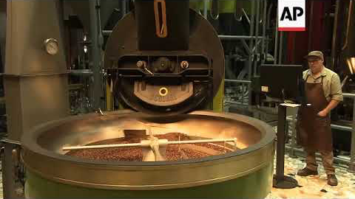
Case Study #2
Starbucks Plans in Italy: Carrying Coal to Newcastle?

Slide 26
Starbucks in Milan- Group Work
What is Starbucks strategy to adjust to the Italian market?
How does Starbucks pay homage to the strong expresso tradition in Italy? Why do they do this?
What products and services have been added compared to the U.S. Starbucks presence? Why?
What would your pricing strategy be? Why?
Describe the ideal customer demographic for the Starbucks Milan store? How would you reach them?

Slide 27
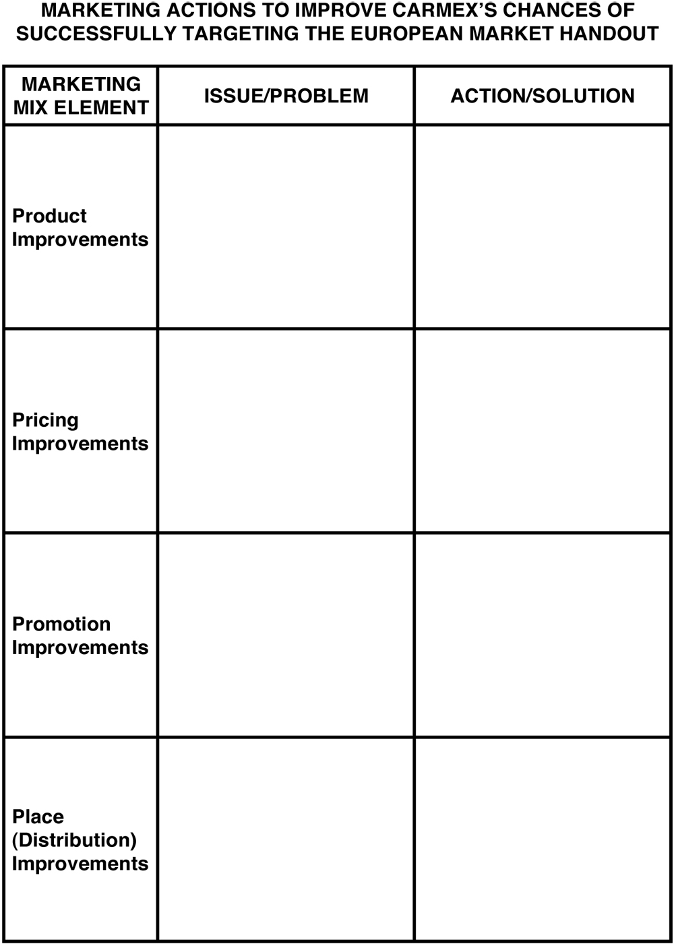
Carmex Handout.
Starbucks in Milan – Group Work

Slide 28
Next week……
Chapter 8, Marketing Research
Be think about what new product or service you would like to launch? Team Marketing Plan project to be assigned Feb. 5
See you next week!

Slide 29
The Rady School of Management
Lecture #7
January 29, 2020
Global Consumers and Markets
Case Study #2 – Starbucks in Milan
MGT103
M,W 11:00a - 12:20p
Winter 2020

